Slide 1






Admira
Student Enquiry and Information Help Desk Agent
Admission Status
Results Check
Accommodation
Tuition & Payments
24/7 Support

Slide 2
THE CHALLENGE
Time-Consuming Processes
Overwhelmed Staff
High volume of repetitive queries
Admira Transforms Student Services
Long wait times for status updates and results
Traditional Process
Admira Solution
Limited Availability
Fragmented Systems
Long wait times
Instant responses
Support unavailable outside business hours
Separate processes causing confusion
Paper forms
Conversational UI
Phone queues
Automated processes
Limited hours
24/7 availability
Student Dissatisfaction
Poor experience leading to negative perception

Slide 3






OUR SOLUTION OVERVIEW
Admira: Intelligent Student Enquiry and Information Help Desk
Admission Status
Results Retrieval
Admissions
Instant access to application status
Secure access to academic results
Support
Accommodation
Tuition & Payments
Payments
Admira SEID
Streamlined booking process
Fee breakdowns and payment options
Results
General Support
Housing
24/7 assistance with seamless escalation to human agents

Slide 4





Process for Creating an Intelligent Agent
A systematic approach to building effective AI solutions
5
1
2
3
4
6
Monitor and Analyze
Make a plan
Knowledge base
Topics
Publishing
Fine Tune
Define objectives, scope, and success metrics
Gather and organize relevant information
Define conversation flows and responses
Deploy to production environment
Optimize based on insights and data
Track performance and user feedback
Iterative Development
User-Centered Design
Data-Driven Optimization

Slide 5

TECHNICAL FOUNDATION
Technology Stack
System Architecture
Students
Core Engine
Data Integration
API Connections
Support
Payments
Copilot Studio
NLP
Real-time Data
Intent Recognition
University Systems
Housing
Admira SEID
Admissions
Cloud Services
Databases
Results
Deployment
Security
Cloud-based
Scalability
Encryption
Compliance
Reliability
Data Protection
Admira: Student Enquiry and Information Help Desk Agent
an autonomous agent befitting logo here

Slide 6






KEY FEATURES
Powerful Capabilities Driving Student Experience
Conversational UI
Multi-Step Workflows
Dynamic Data Lookup
Natural language understanding for intuitive, human-like interactions
Guided processes for complex tasks like accommodation booking
Real-time access to university databases for instant information
Understands casual queries
Step-by-step guidance
Live admission status checks
Supports multiple languages
Form filling assistance
Current results retrieval
Adapts to student preferences
Progress tracking for long processes
Real-time room availability
Context Awareness
Smart Escalation
Remembers conversation history for coherent, personalized interactions
Seamless handoff to human agents for complex issues and complaints
Remembers student ID across sessions
Automatic detection of complex queries
Understands follow-up questions
Context transfer to human agents
Provides personalized responses
Priority queuing for urgent issues

Slide 7


USER JOURNEY
Seamless Interaction Flow for Every Student Need
Admission Status Check
Results Check
1
Student Initiates
1
Student Query
"Check my admission status"
"Show my semester results"
2
Authentication
2
Verification
Admira requests student ID and verification
Confirms student identity
3
Data Retrieval
3
Results Access
Accesses admissions database
Retrieves academic records
4
Status Update
4
Results Display
Provides current status and next steps
Shows grades and GPA with analysis
Admira: Student Enquiry and Information Help Desk Agent
[Your Company Logo] | www.yourcompany.com

Slide 8


USER JOURNEY
Seamless Interaction Flow for Every Student Need
Accommodation Booking
Tuition & Payment Enquiries
General Info & Complaints
1
Request Initiated
1
Payment Question
1
Student Inquiry
"I need to book a hostel room"
"How much is my tuition fee?"
"I have a complaint about..."
2
Preference Collection
2
Student Verification
2
Issue Classification
Gathers room preferences and budget
Identifies student program
Identifies complaint category
3
Availability Check
3
Fee Structure
3
Resolution Attempt
Displays available options
Provides detailed breakdown
Provides automated solution if possible
4
Booking Confirmation
4
Payment Options
4
Escalation (if needed)
Completes reservation with details
Explains payment methods and deadlines
Connects to human agent with context
Admira: Student Enquiry and Information Help Desk Agent

Slide 9














INTEGRATION & SCALABILITY
Seamless Integration
University Systems
Admira Integration Ecosystem
Connects to LMS, student databases, and administrative systems
Multi-Platform Support
Admira SEID
Compatible with web portals, mobile apps, and messaging platforms
API-First Architecture
RESTful APIs for easy integration with existing infrastructure
Admissions
Results
Housing
Enterprise Scalability
High Volume Handling
Manages peak loads during admission and result periods
Payments
LMS
Help Desk
Modular Design
Easy addition of new features and capabilities
Admira: Student Enquiry and Information Help Desk Agent
[Your Company Logo] | www.yourcompany.com

Slide 10
MEASURABLE BENEFITS
Driving Tangible Results Across Student Services
Efficiency Gain
Cost Savings
70%
45%
Reduction in manual query handling time
Reduction in operational costs for helpdesk services
Avg. response time: < 30 sec
Lower staffing requirements during peak periods
Staff hours saved: 40+/week
ROI achieved within 6 months
Student Satisfaction
Accessibility
85%
24/7
Increase in positive feedback from students
Support availability eliminating wait times
Service rating: 4.7/5
Queries handled: 500+/day
Reduced complaint volume by 60%
Multi-platform access for all students

Slide 11
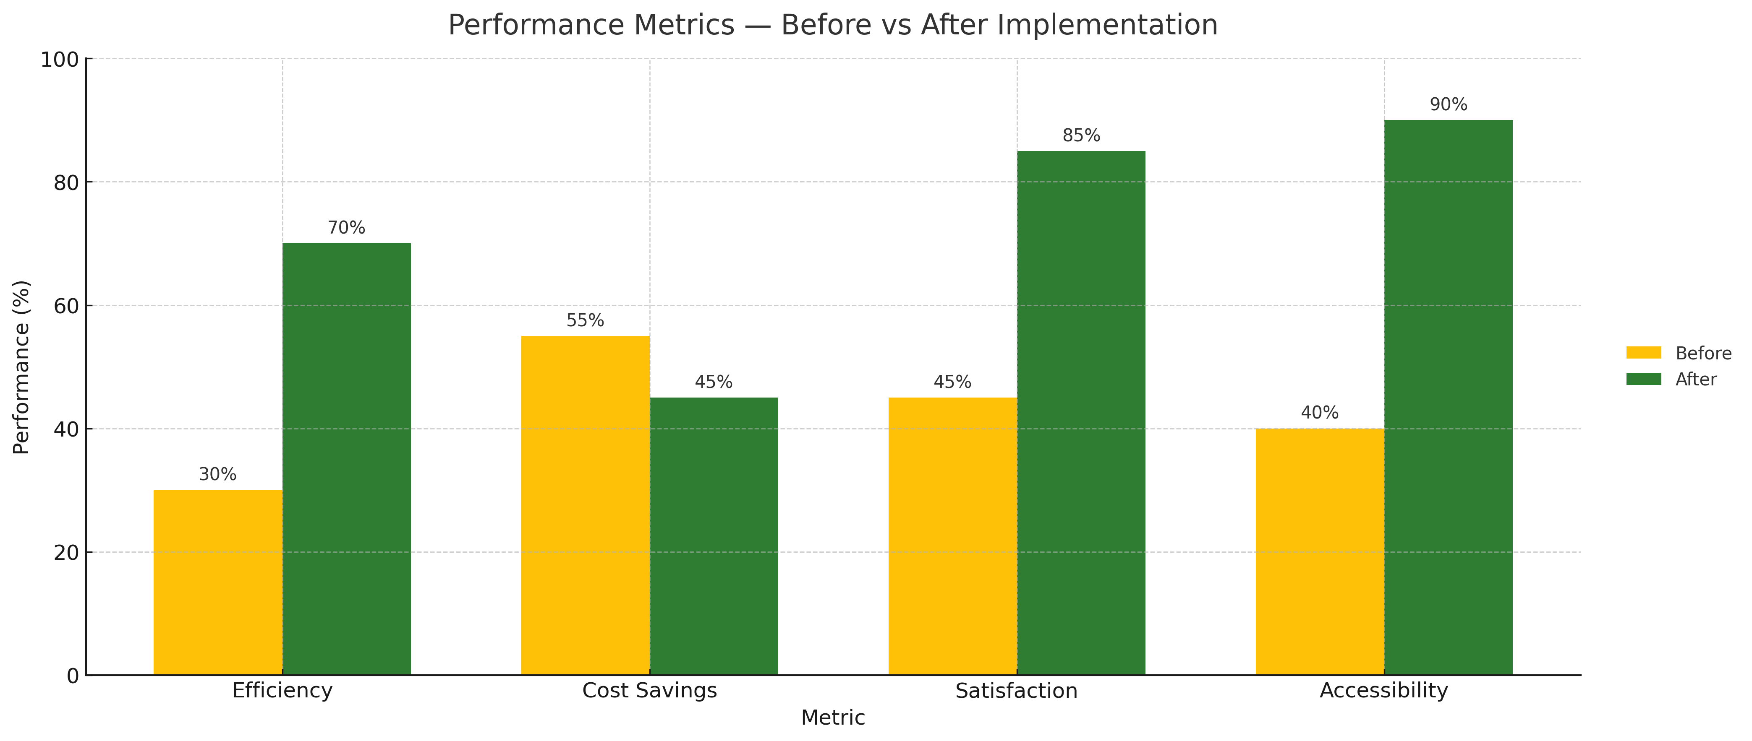
MEASURABLE BENEFITS
Impact Visualization
Admira: Student Enquiry and Information Help Desk Agent

Slide 12




Roadmap & Partnership
A Collaborative Path Forward
1
2
3
4
Pilot Phase
Optimization
University-Wide Rollout
Advanced Phases
Deploy in one faculty to test core functions
Refine based on analytics and user input
Scale across all departments with full feature set
Voice integration, multilingual support, predictive analytics
1-2 Months
1 Month
2-3 Months
Ongoing
Collaborative Implementation
Data-Driven Optimization
Stakeholder Engagement

Slide 13
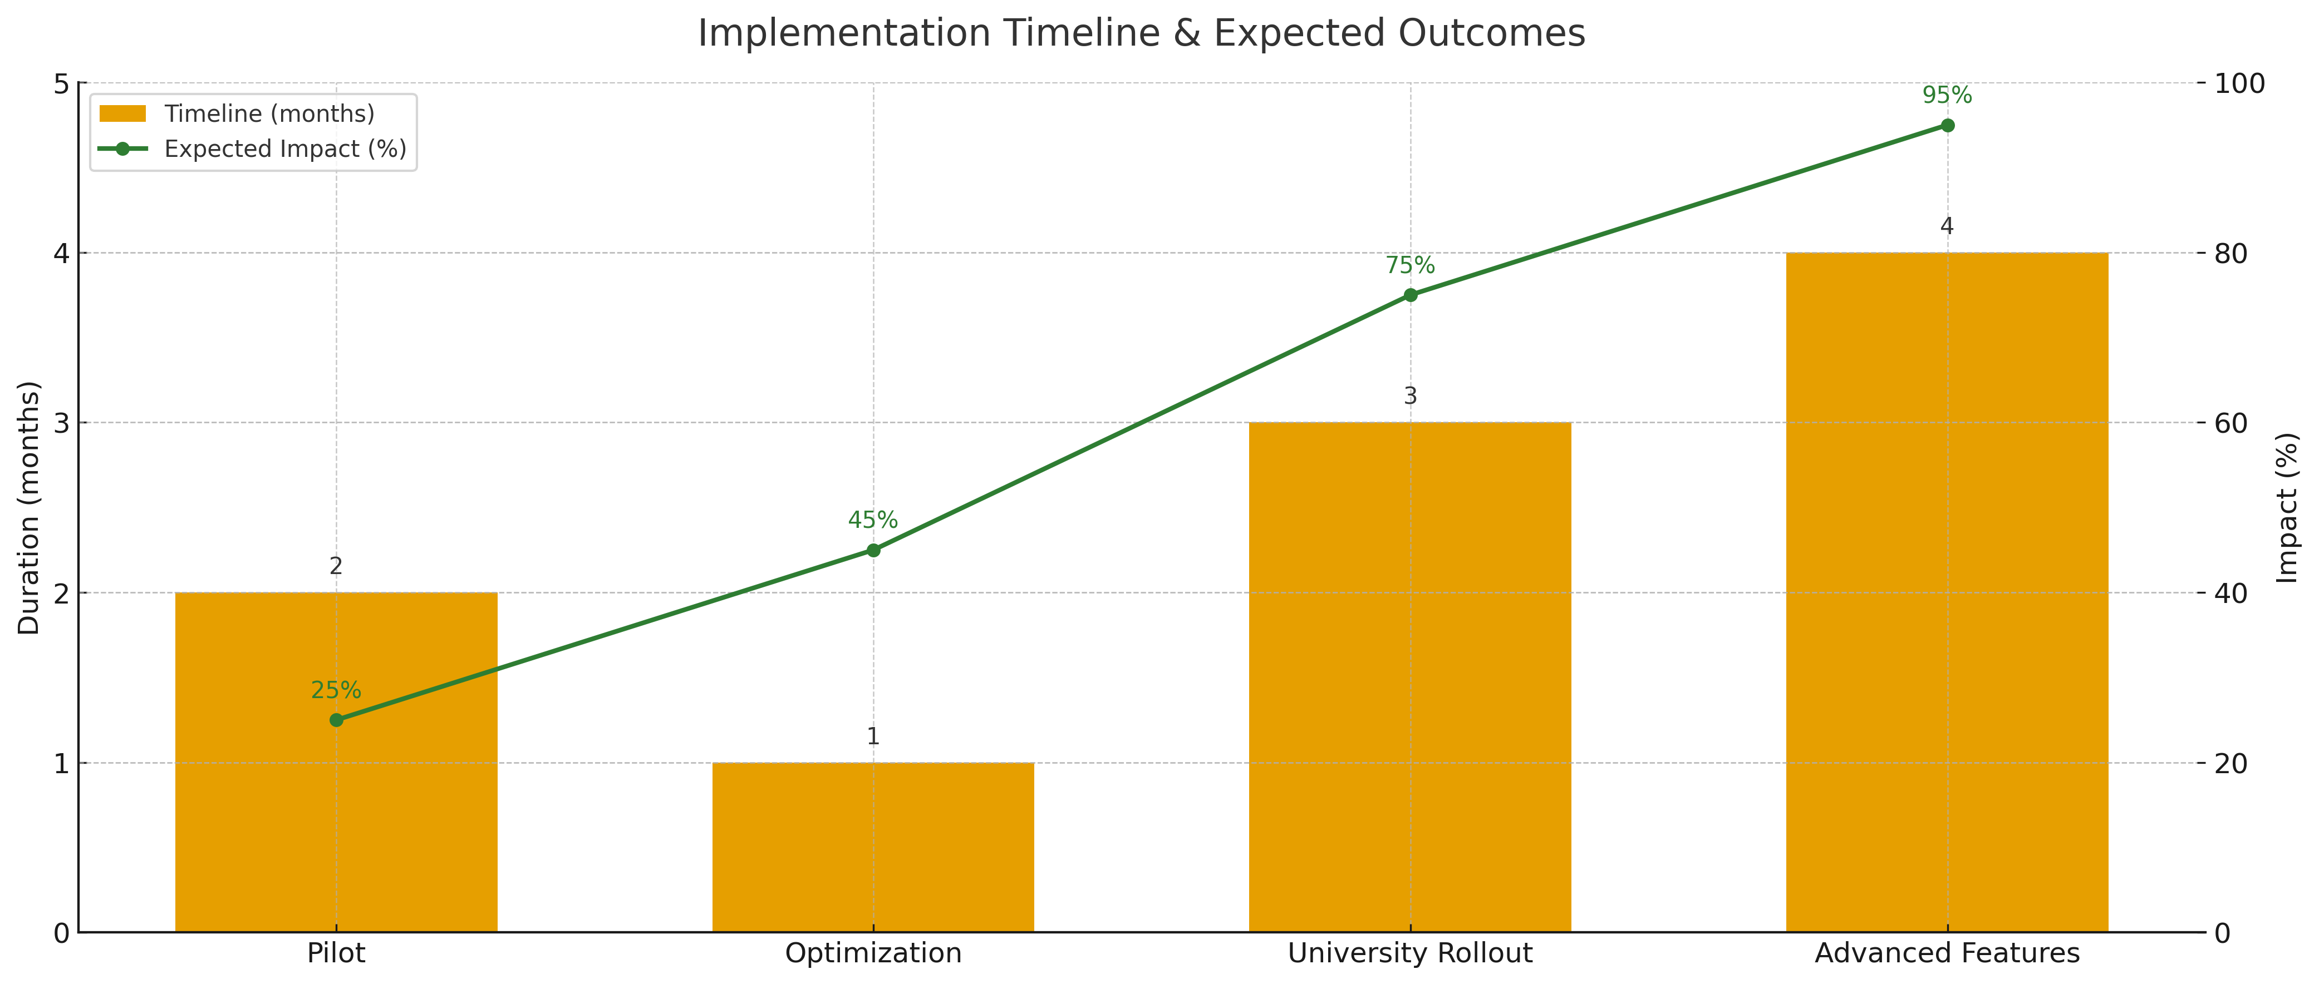
ROADMAP & PARTNERSHIP
A Collaborative Path Forward

Slide 14


Contact & Next Steps
Transform Your Student Services Today
Partner with innovation to empower your students
Solutions Architect
Email Address
Admira SEID
Phone Number
Company Website
Revolutionizing Student Services with AI
Learn More
Efficiency
Satisfaction
Growth
Let's Connect
Admira: Student Enquiry and Information Help Desk Agent

Slide 15

THANK YOU
Transforming student services with AI-powered innovation
24/7 Student Support
70% Efficiency Improvement
Seamless Integration
contact@admira.ai
www.admira.ai
Admira: Student Enquiry and Information Help Desk Agent

